Slide 1



Measuring Internet Connectivity
Practical tools exploration
Bayar Batjargal
APNIC
CAPIF-4, Almaty, Kazakhstan, Sep 2025

Slide 2



Internet Connectivity Measurement
1990s
2000s
2010
  Early efforts in the focused primarily on basic network diagnostics (e.g., Ping and Traceroute) to test packet delivery and route paths (Vern Paxson, 1997). These early tools provided critical insights into packet loss, latency, and routing anomalies but were limited in scope and scale.
  Systematic measurement platforms rose. Projects such as CAIDA (Cooperative Association for Internet Data Analysis) and PlanetLab provde more scientific foundation, enabling researchers to run controlled experiments on a global scale.
  Since the 2010s, initiatives like RIPE Atlas and M-Lab (Measurement Lab) have expanded the accessibility of measurement to regulators, policymakers, researchers, and end-users.
Notes:
1990s Early efforts in the focused primarily on basic network diagnostics (e.g., Ping and Traceroute) to test packet delivery and route paths (Vern Paxson, 1997). These early tools provided critical insights into packet loss, latency, and routing anomalies but were limited in scope and scale.
By the 2000s, academic and industry interest grew in systematic measurement platforms. Projects such as CAIDA (Cooperative Association for Internet Data Analysis) and PlanetLab sought to provide a more scientific foundation, enabling researchers to run controlled experiments on a global scale. These efforts laid the groundwork for the development of large-scale distributed measurement platforms, focusing on transparency, reproducibility, and openness of data
Since the 2010s, initiatives like RIPE Atlas and M-Lab (Measurement Lab) have expanded the accessibility of measurement to regulators, policymakers, researchers, and end-users. These platforms not only measure performance metrics like latency, jitter, packet loss, DNS resolution times, and throughput, but also provide global, crowd-sourced perspectives on the state of internet connectivity. Today, internet measurement is recognized as a cornerstone of digital policy, cybersecurity, and global connectivity research.

Slide 3

Why Internet Connectivity Measurement is Important
Quality of Service (QoS) and Accountability: Ensures that users receive the internet performance promised by ISPs and helps regulators enforce standards.
Digital Inclusion: Identifies connectivity gaps between rural/urban and developed/developing areas, guiding efforts to close the digital divide.
Economic & Social Development: Strong internet infrastructure drives growth in e-commerce, digital finance, education, and telemedicine
Policy & Infrastructure Planning: Provides evidence for investments in broadband, data centers, or cross-border fiber-optic networks.

Slide 4
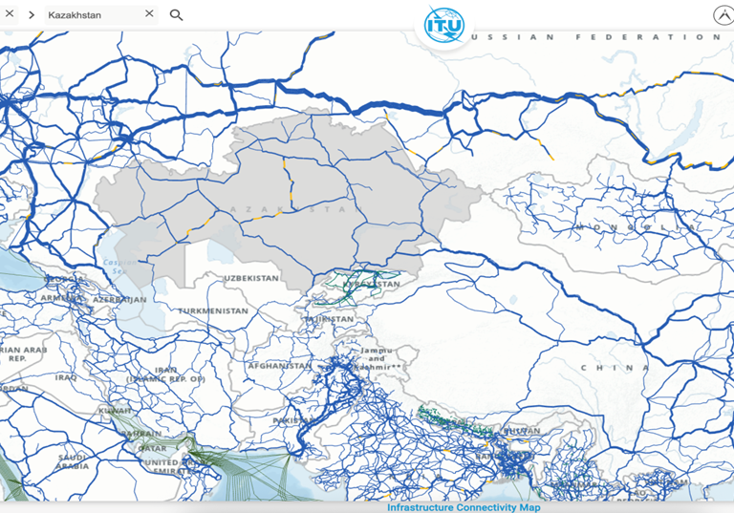
Why Internet Connectivity Measurement is Important
Quality of Service (QoS) and Accountability: Ensures that users receive the internet performance promised by ISPs and helps regulators enforce standards.
Economic & Social Development: Strong internet infrastructure drives growth in e-commerce, digital finance, education, and telemedicine
Digital Inclusion: Identifies connectivity gaps between rural/urban and developed/developing areas, guiding efforts to close the digital divide.

Slide 5





Economies growing in Central Asian countries

Slide 6
Methodology
  Identify the target IP addresses
  Select source ASNs for the measurement
  Perform the measurement using RIPE Atlas
  Keep measuring if there is any improvement over time

Slide 7
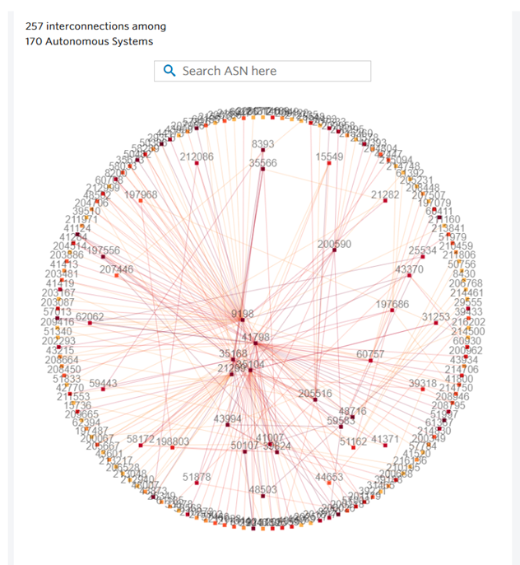
1
Identify the target IP addresses
  Target country - Kazakhstan
  Find out the most connected ASN in Kazakhstan in APNIC REX (either AS9198 or AS41798)
  APNIC Labs Stats -> AS9198 is the major upstream provider in Kazakhstan
  Target IP address (37.150.80.101) announced by AS9198
rex. apnic.net - select AS interconnections https://stats.labs.apnic.net/aspop https://bgp.he.net/AS9198#_prefixes

Slide 8
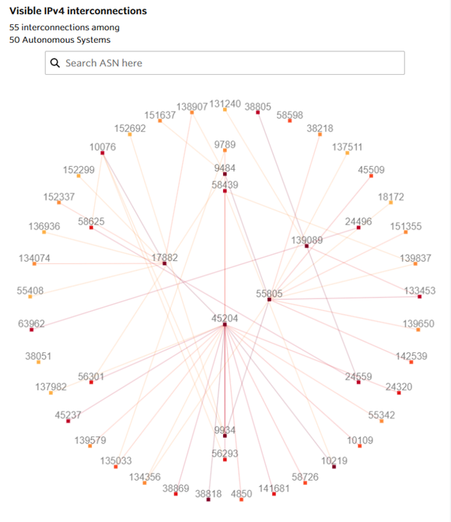
2
Source ASN selection
  Used the same approach to identify the most connected ASNs in Mongolia
  Selected AS45204 (Gemnet) and 55805 (Mobicom Networks)
www. Telecom.kz
www.mobicomnetworks.mn
www.gemnet.mn

Slide 9
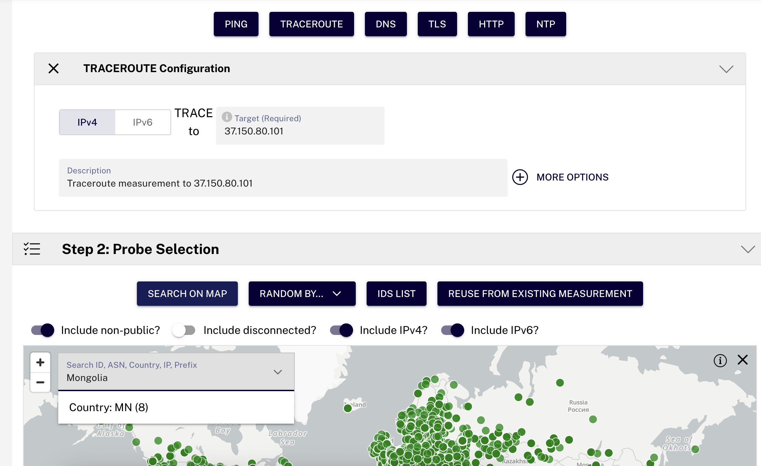
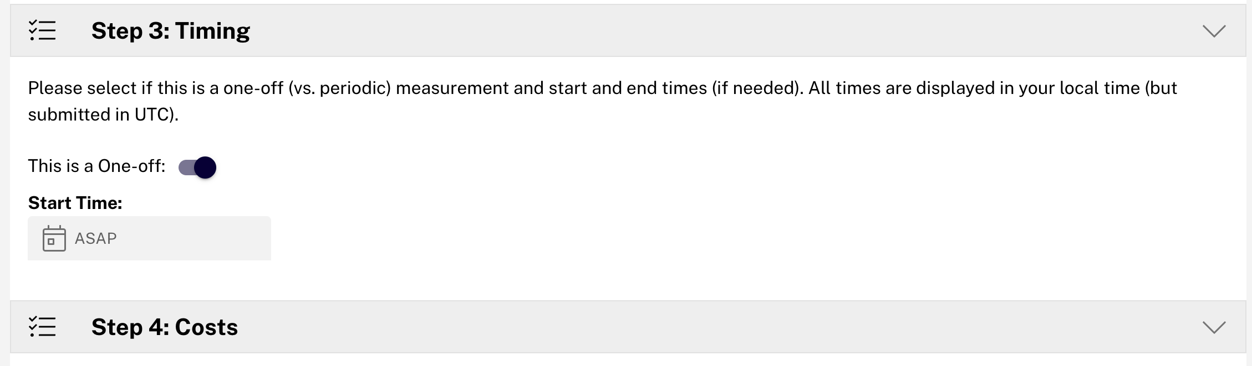
3
Perform the measurement
  Set target IP address
  Select the type of measurement
    its traceroute with ICMP in my case
  Probe selection is must (keep the random 50 probes, which is a + point)
www.atlas.ripe.net

Slide 10
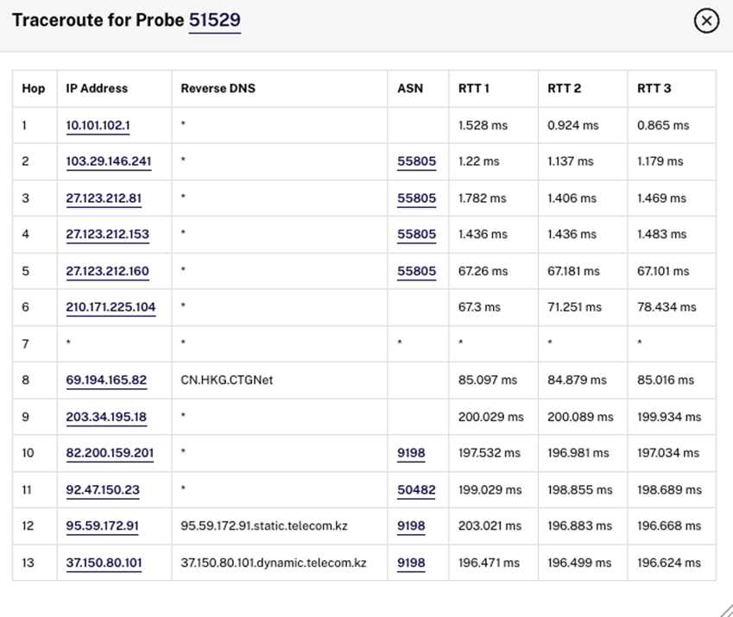
4
Results
  Select active probes in Mongolia for AS45204 and AS55805 in RIPE Atlas
  Performed the traceroute and ping measurements
Traceroute from AS55805 to AS9198

Slide 11
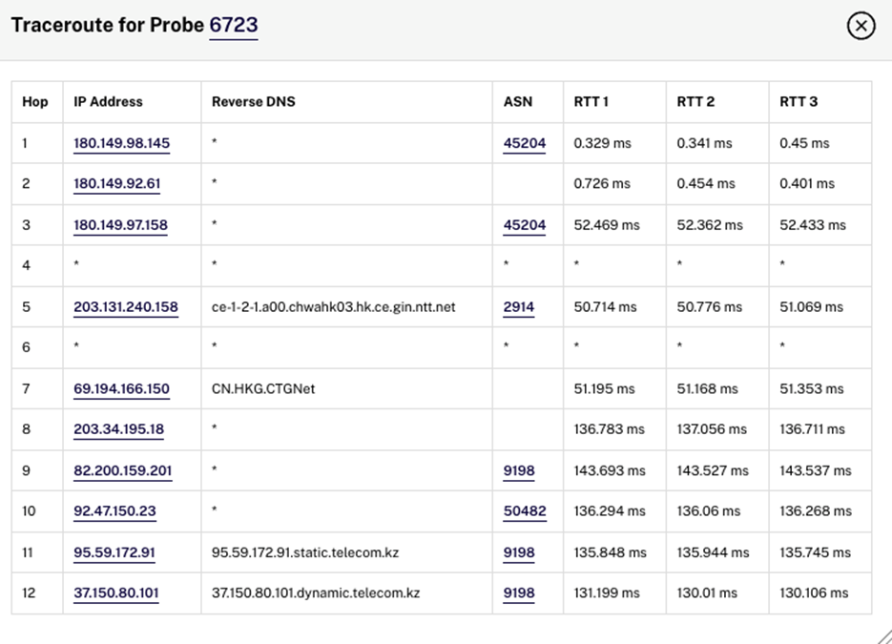
4
Results
  Select active probes in Mongolia for AS45204 and AS55805 in RIPE Atlas
  Performed the traceroute and ping measurements
Traceroute from AS45204 to AS9198

Slide 12
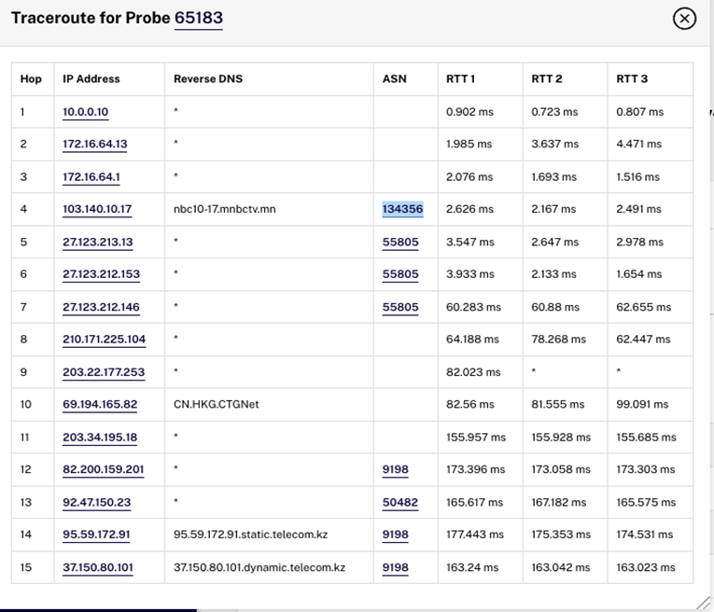



From the customer of 55805
  Trace the result from an ISP

Slide 13
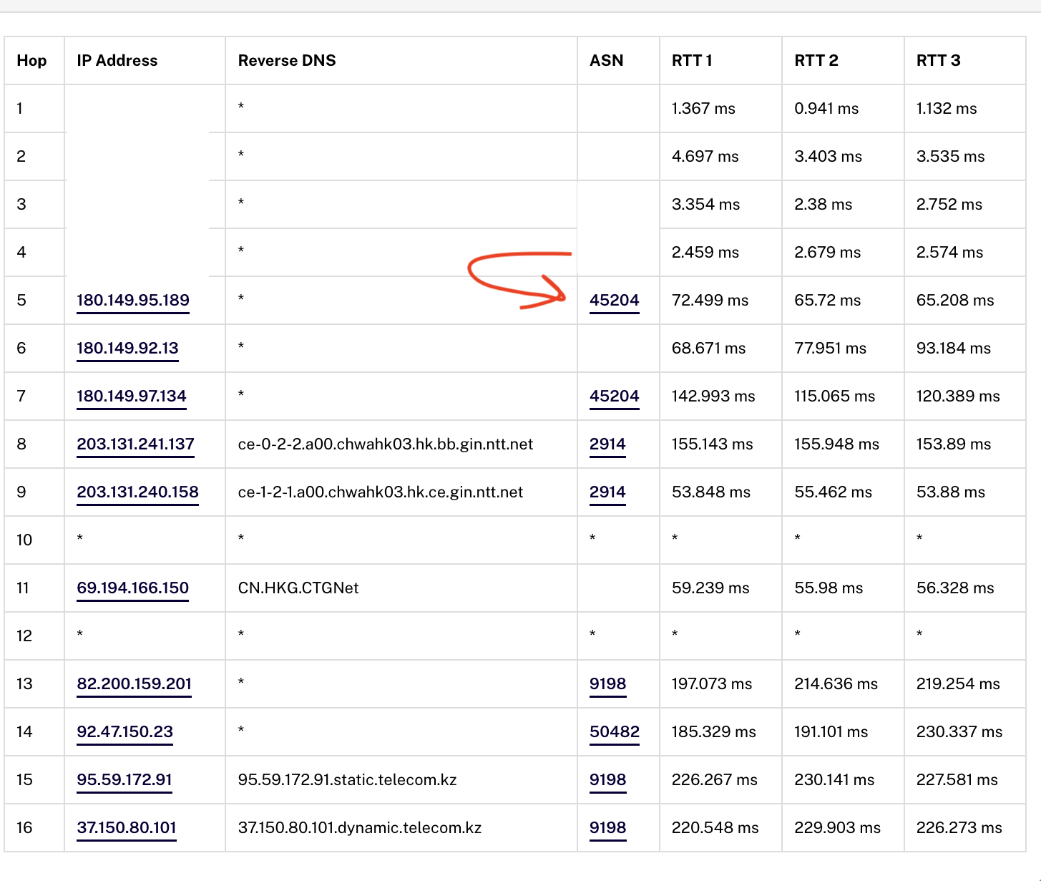
From customer of 45204
  Trace result from the customer of AS45204 during the peak hour

Slide 14
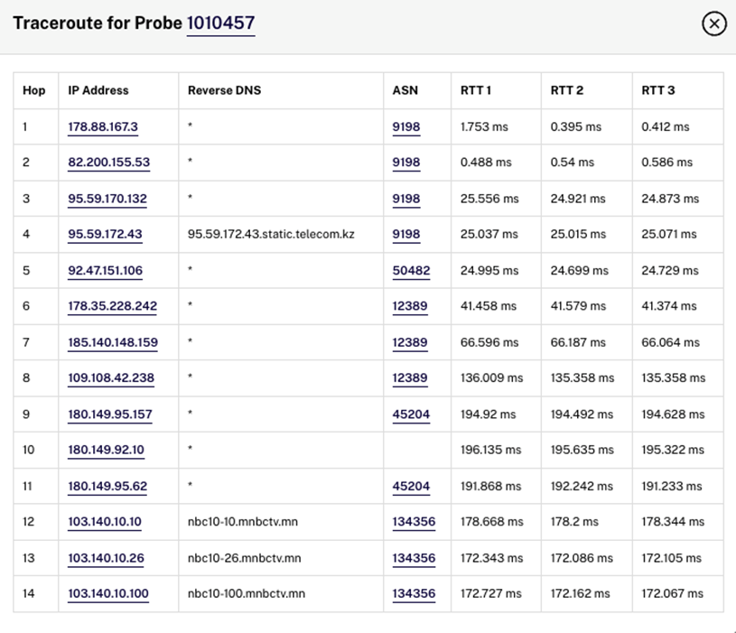
Reverse traceroute from KZ to MN
  AS 9198 to AS 134356 (103.140.10.100)
  Return traffic chooses AS45204
  Measurement ID: 127750848

Slide 15
Reverse traceroute from KZ to MN
  202.131.224.2 – advertised by AS9484
  Measurement: 127750848

Slide 16
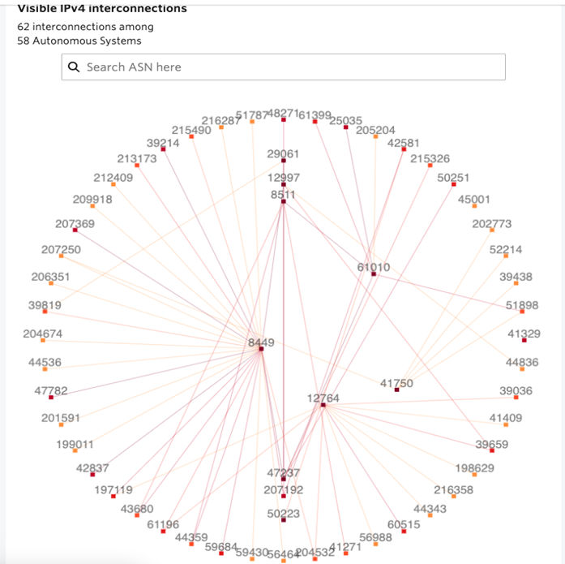
Same test for Kyrgyzstan
Selected AS8449 –Elcat as the destination
  The most advertised IP address should be the DNS IP for Elcat, probably, advertised to all its upstreams. IP: 212.42.96.1
$nslookup ns1.elcat.kg
…
Name: ns1.elcat.kg
Address: 212.42.96.1
Name: ns1.elcat.kg
Address: 2a00:7160::1

Slide 17
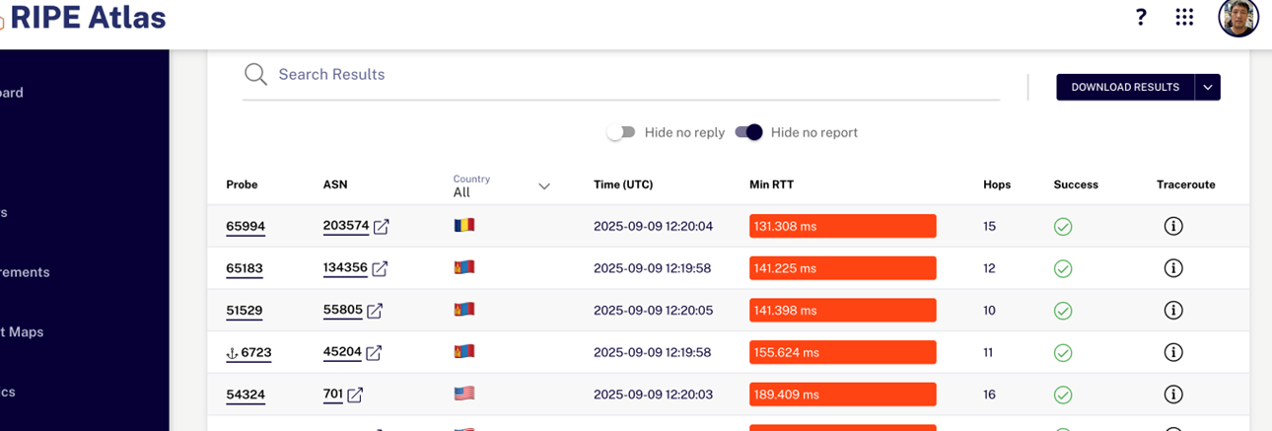
Kyrgyzstan
Trace results from 50 random ASN to the same target IP: 212.42.96.1

Slide 18
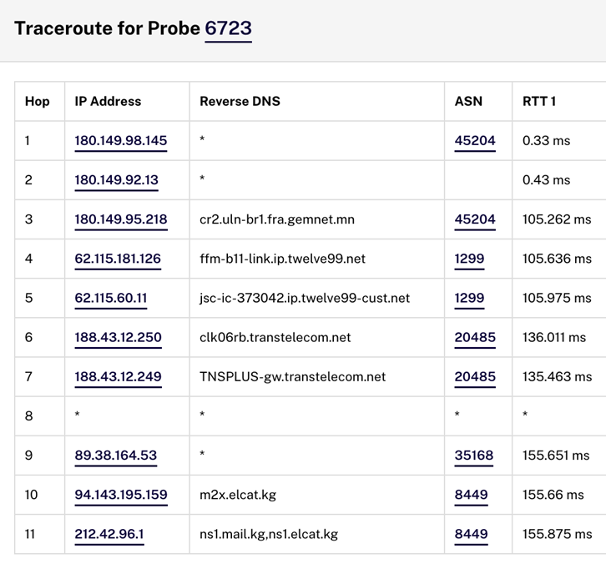
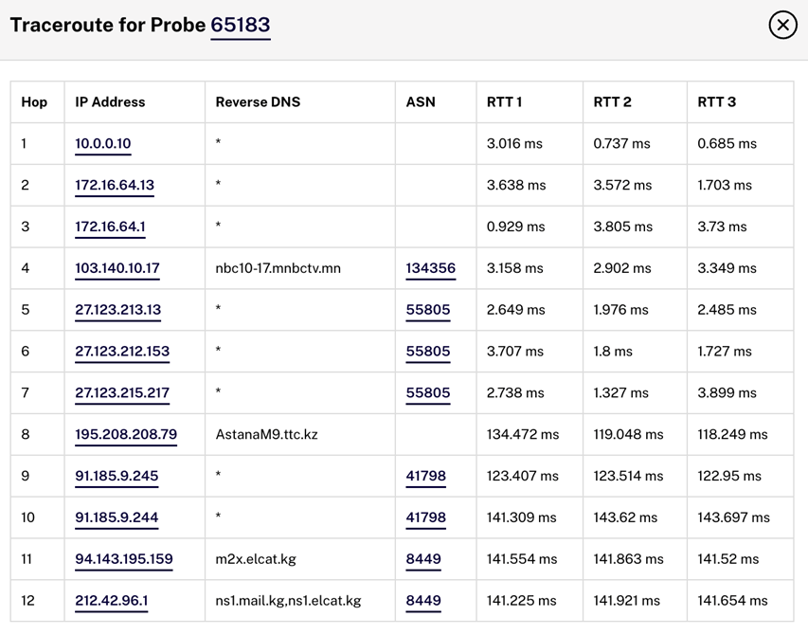
Kyrgyzstan

Slide 19
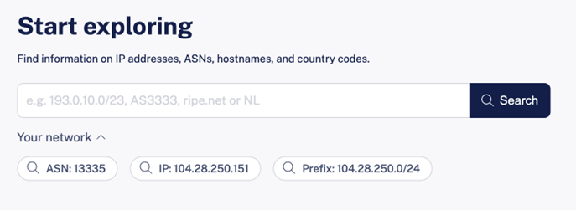
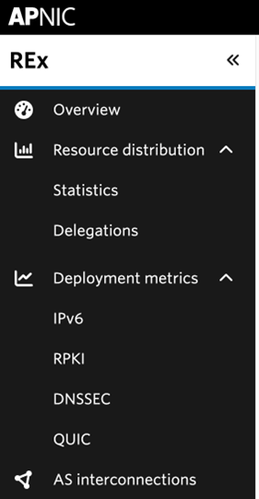
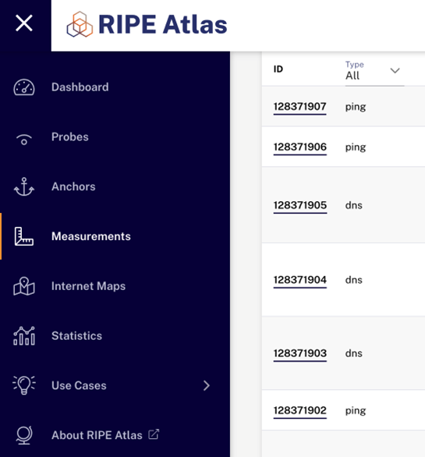
Wrap up
  Measuring the connectivity is simple
  Regular checks is recommended (different times and days
  Available free tools
    https://labs.apnic.net/measurements/
    https://stat.ripe.net
    APNIC REX - Resource eXploration:
    https://rex.apnic.net/about
  Do your own measurements, or check
    others
    RIPE Atlas – www.atlas.ripe.net
And human networking !!!

Slide 20
Challenges encountered
  Some limitations on identifying major ASNs using CAIDA AS ranking
  Credits required in RIPE Atlas to run the measurement
  Some critics from the audience on why you are measuring my connectivity
Potential improvements
  Run the measurement in other countries in Central Asia
  Regularly monitor the results
  Talk to peering partners, providers

Slide 21

Thank You

